Slide 1
Capstone Project
Ajith R
NYC Taxi Trip Time Prediction Analysis

Slide 2

Contents
Data Summary Data Preprocessing Univariate Analysis Bivariate Analysis
Model Implementation Challenges Faced Conclusion

Slide 3
Data Summary
Dataset | NYC Taxi Data.csv
Data Description | The dataset is based on the 2016 NYC Yellow Cab trip record data made available in Big Query on Google Cloud Platform. The data was originally published by the NYC Taxi and Limousine Commission (TLC). The data was sampled and cleaned for the purposes of this project.
Problem Description | The task is to build a model that predicts the total ride duration of taxi trips in New York City. Your primary dataset is one released by the NYC Taxi and Limousine Commission, which includes pickup time, geo-coordinates, number of passengers, and several other variables.
Shape | 1458644 rows and 11 columns

Slide 4
Data Fields:
id - a unique identiﬁer for each trip
vendor_id - a code indicating the provider associated with the trip record
pickup_datetime - date and time when the meter was engaged
dropoff_datetime - date and time when the meter was disengaged
passenger_count - the number of passengers in the vehicle (driver entered value)
pickup_longitude - the longitude where the meter was engaged
pickup_latitude - the latitude where the meter was engaged
dropoff_longitude - the longitude where the meter was disengaged
dropoff_latitude - the latitude where the meter was disengaged
store_and_fwd_ﬂag - This ﬂag indicates whether the trip record was held in vehicle memory before sending to the vendor because the vehicle did not have a connection to the server - Y=store and forward; N=not a store and forward trip
trip_duration - Duration of the trip in seconds. This is also our target variable.

Slide 5

Data Preprocessing :
Checking for null values and removing them.
Converting data types.
Checking whether column renaming is required.
Creating new columns if required.
One hot encoding.

Slide 6
Univariate Analysis

Slide 7
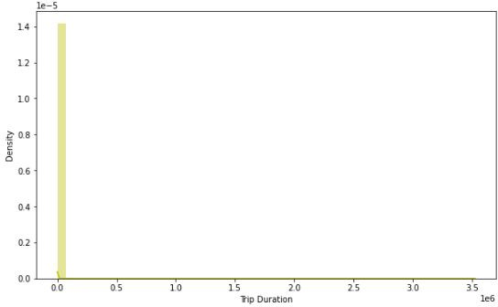
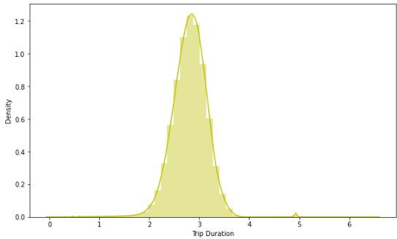
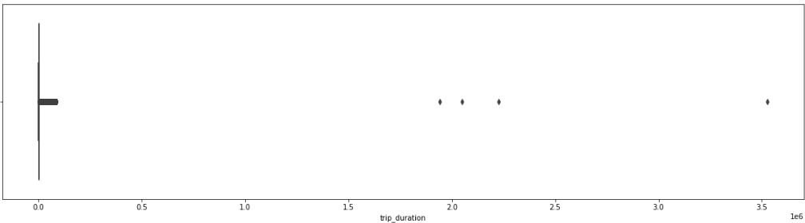
Dependent Variable - Trip Duration

Slide 8
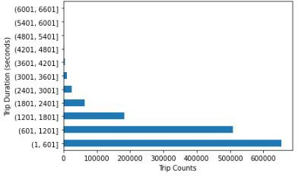
Trip counts grouped in terms of 600 seconds

Slide 9
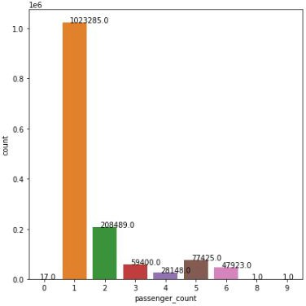
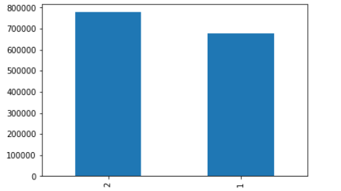
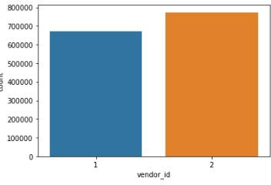
Vendor id and passenger count plot

Slide 10
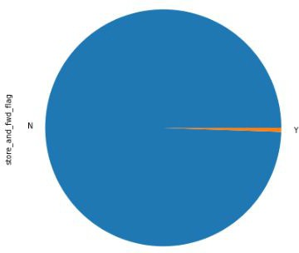
Store and Forward Flag

Slide 11
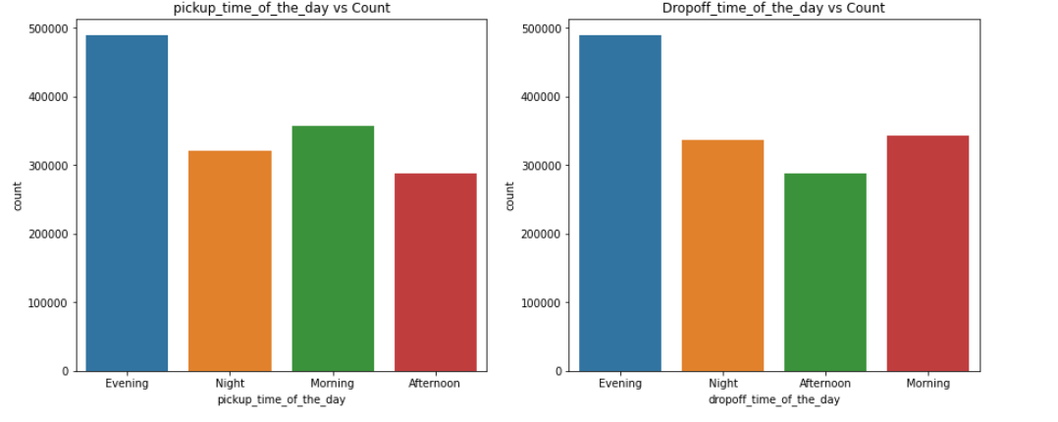
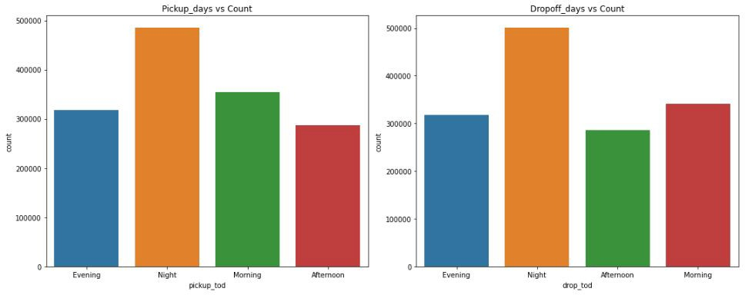
Pickup and Drop count based on time of the day

Slide 12
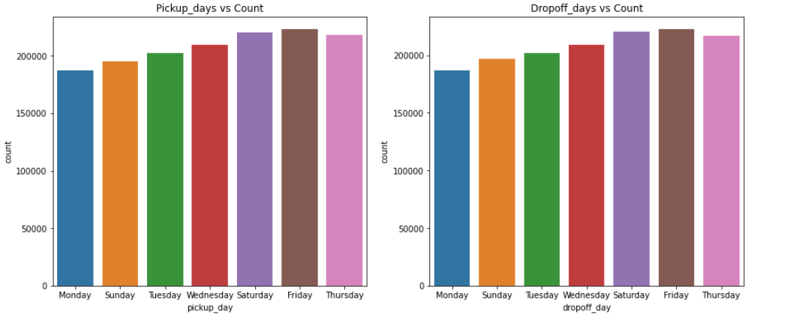
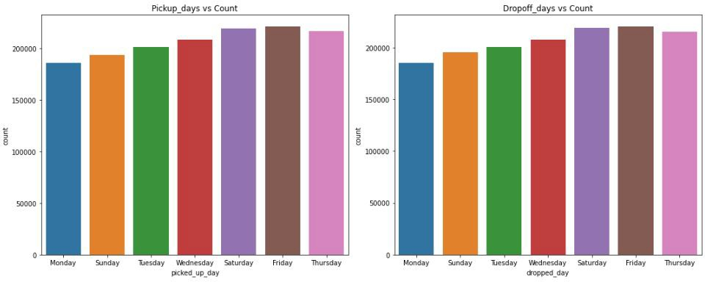
Pickup and Drop day wise countplot

Slide 13
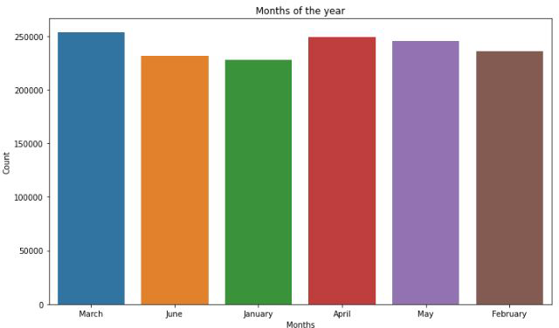
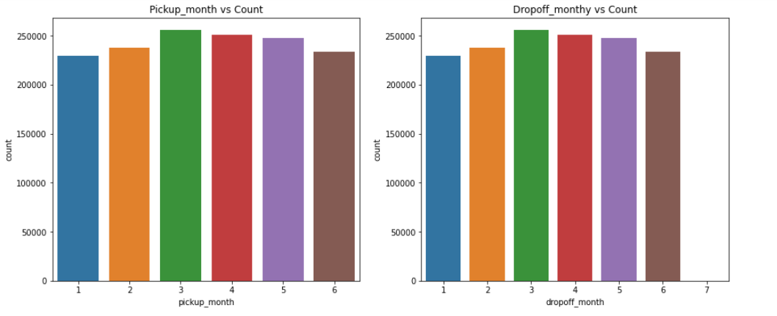
Countplot for months

Slide 14
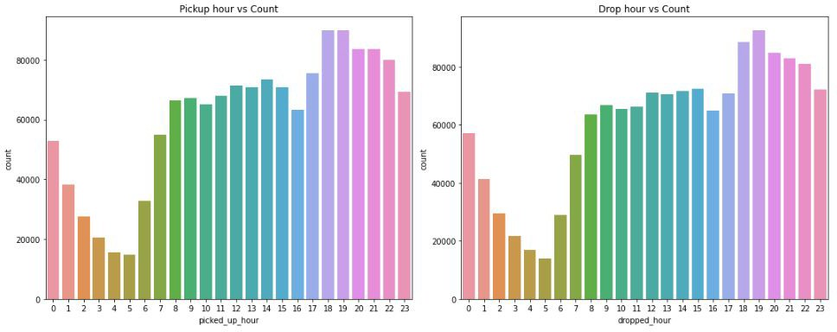
Pickup and Drop hour

Slide 15
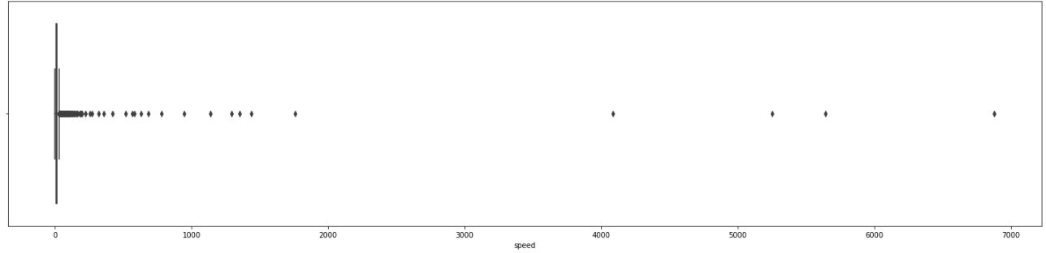
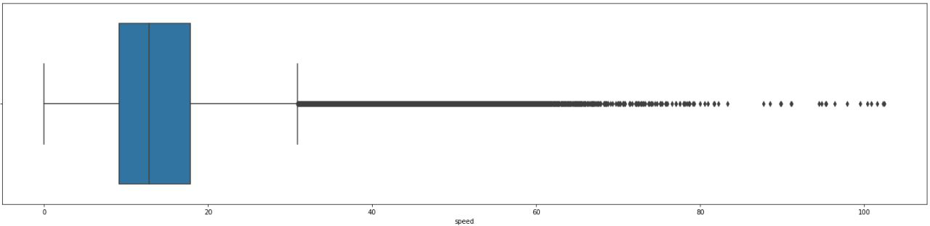
Speed before outlier removal
Speed after outlier removal

Slide 16
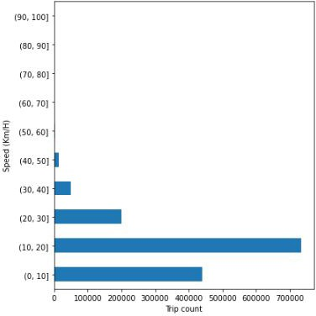
Trip count grouped by 10 km/hr

Slide 17
Bivariate Analysis

Slide 18
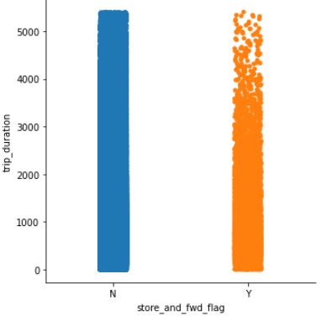
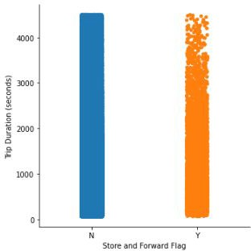
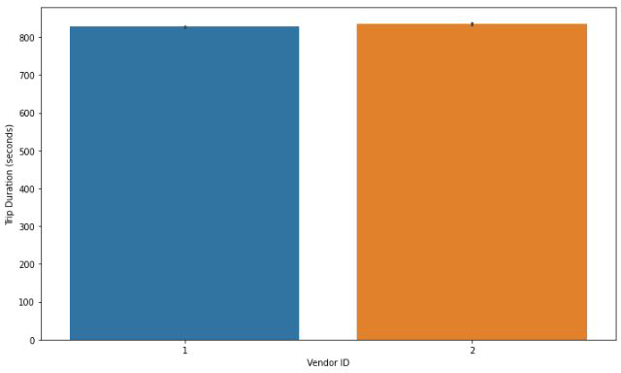
Trip Duration v/s Store and Forward Flag
Trip Duration v/s Vendor ID

Slide 19
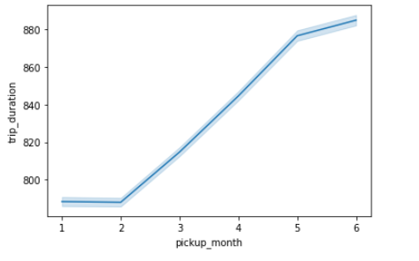
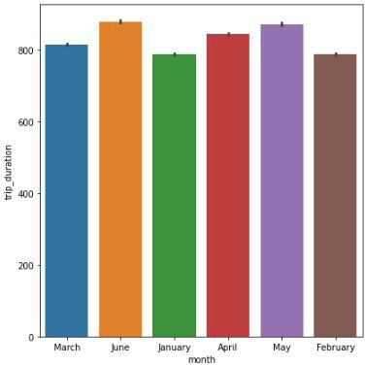
Trip Duration v/s Month

Slide 20
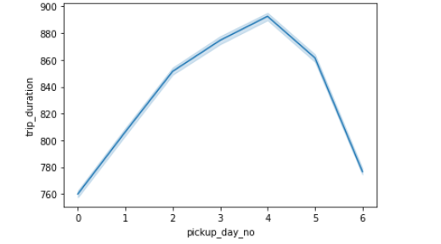
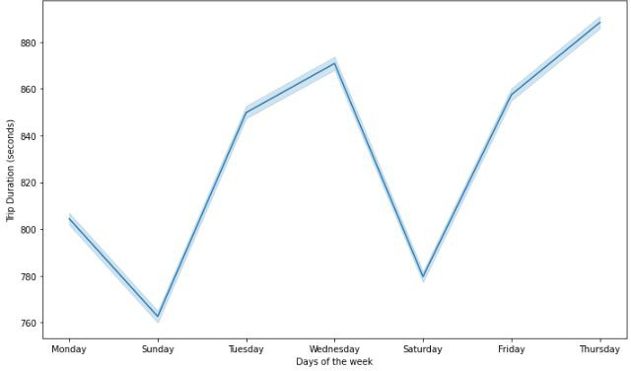
Trip Duration v/s Days of the Week

Slide 21
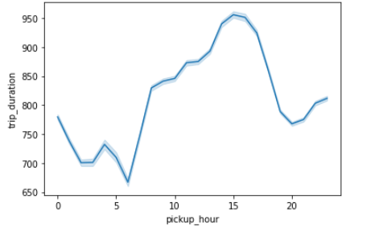
Trip Duration per Hour

Slide 22
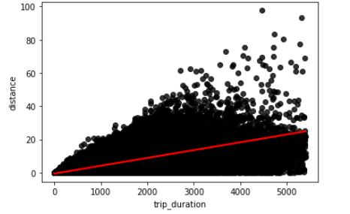
Distance vs Trip Duration

Slide 23
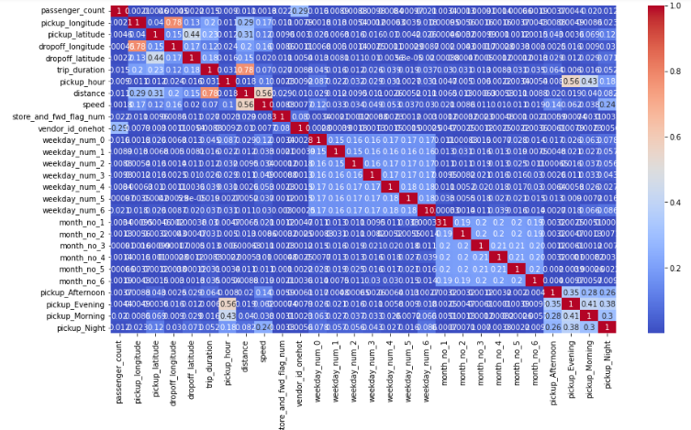
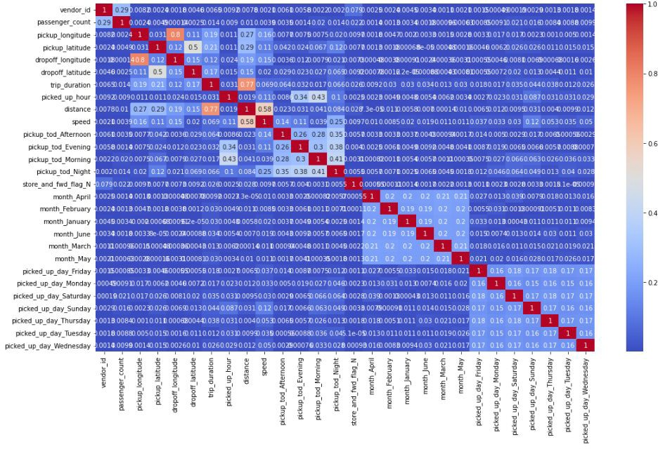
Heatmap for correlation

Slide 24
Model Implementation and Validation

Slide 25
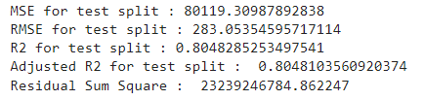

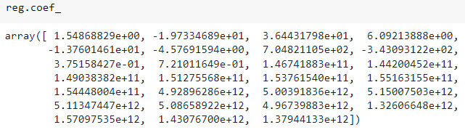
Model Validation and Selection (Regression)
Multiple Linear Regression
Test set Train set

Slide 26
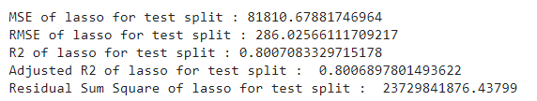
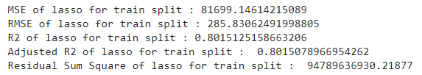
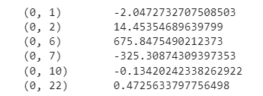
Lasso regression
Test set Train set
- pickup longitude
- pickup_latitude
- distance
- speed
- weekday_num_0
- month_no_6

Slide 27
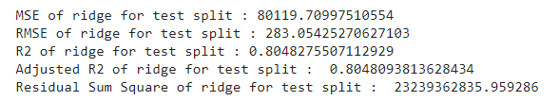
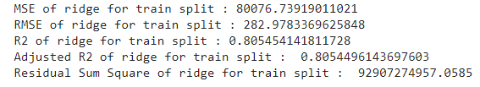
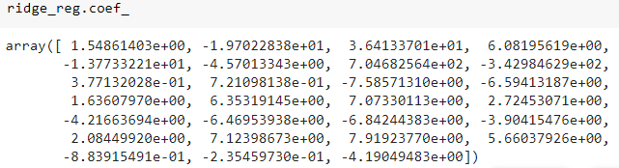
Ridge regression
Test set Train set

Slide 28
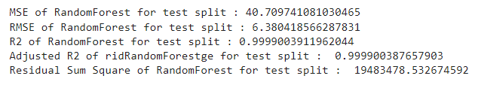
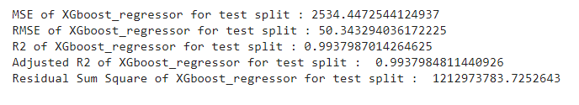

Random Forest Regressor
XGboost Regressor

Slide 29
Model Validation and Selection (Regression)
Observation 1:
Linear, Lasso and Ridge regression have the same r^2 score of 80% which is a good score.
Observation 2:
Random Forest is best when compared to all other models, also it has the lowest MSE of all

Slide 30
Challenges
Huge dataset.
Computation Time.

Slide 31
CONCLUSION
* Out of all the models Randomforest Regressor performed well in prediction of trip duration time with R2 score of 99.99% and also XGBoost Regressor did well too
* Linear Regression model too performed well with R2 score of 80.48% which is'nt a bad score but we had to drop correlated variables for linear assumption
* Whereas both ensemble models did well when we included correlated variables since they're Non parametric models
* RandomForest Regressor has the best score and less error, also if we compare with Residual sum squares this model has the least value
* RandomForest Regressor is the best model for trip duration prediction

